Slide 1
Starter
Write down the number 24.98063 to the following number of significant figures:
1sf | 20
2sf | 25
3sf | 25.0 (the .0 is required!)
4sf | 24.98
5sf | 24.981
?
?
?
?
?

Slide 2

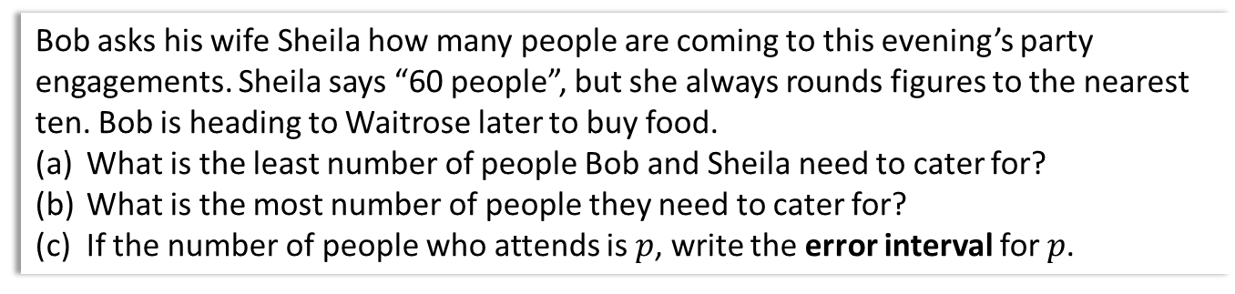
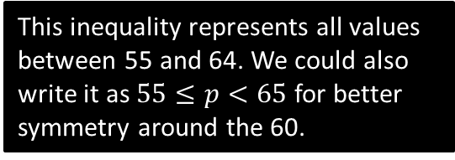
Why have bounds?
Bob asks his wife Sheila how many people are coming to this evening’s party engagements. Sheila says “60 people”, but she always rounds figures to the nearest ten. Bob is heading to Waitrose later to buy food.
What is the least number of people Bob and Sheila need to cater for?
What is the most number of people they need to cater for?
If the number of people who attends is $p$, write the error interval for $p$.
This is known as the lower bound.
a
?
55 is the smallest number that rounds to 60 to the nearest 10. So there must be at least 55 people coming.
64 is the largest number that rounds to 60. This is therefore the most.
$55≤p≤64$ where $p$ is an integer
! The error interval is the range of values the (unrounded) quantity can take.
b
?
This inequality represents all values between 55 and 64. We could also write it as $55≤p<65$ for better symmetry around the 60.
c
?
The purpose therefore of bounds to have a range of possible values a recorded quantity might have been before it was rounded. This can be useful for planning for ‘best case’ and ‘worse case’ scenarios.

Slide 3
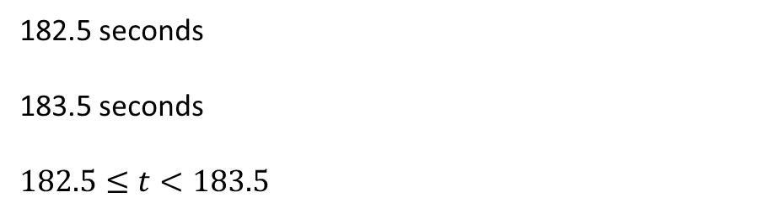
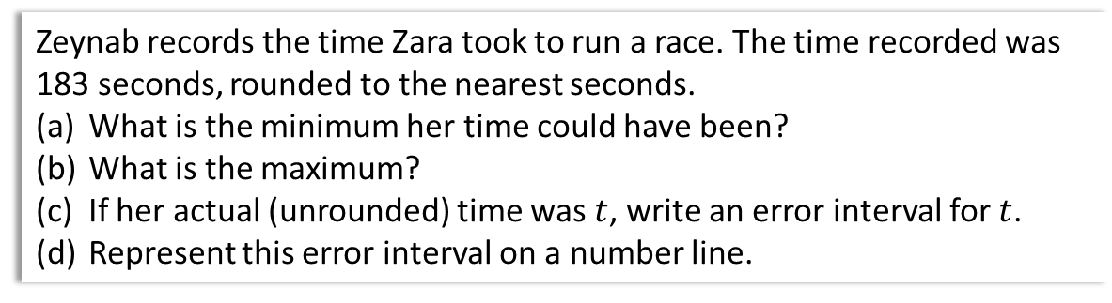

Further Example
Zeynab records the time Zara took to run a race. The time recorded was 183 seconds, rounded to the nearest seconds.
What is the minimum her time could have been?
What is the maximum?
If her actual (unrounded) time was $t$, write an error interval for $t$.
Represent this error interval on a number line.
a
?
182.5 seconds
183.5 seconds
$182.5≤t<183.5$
182.4 would have rounded to 182 not 183
b
?
This is confusing because 183.5 rounds to 184 seconds! What we really mean is 183.49999…, i.e. a value infinitesimally just below 183.5. But it’s possible to prove that 183.49999… = 183.5, so we just write 183.5.
c
?
Note that this inequality includes the 182.5, but doesn’t include the 183.5 (as per above discussion)
d
?
Recall that a filled circle means the value is included, and an unfilled one means the value (of 183.5) is not included.
181 182 183 184
Time $t$ (secs)

Slide 4
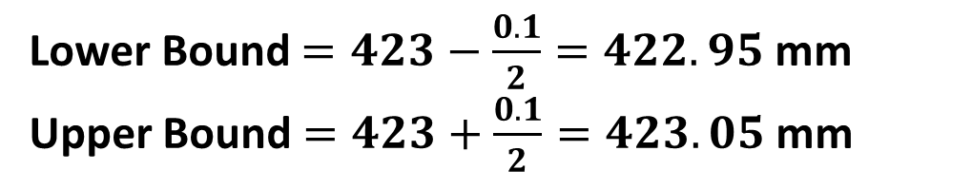
Easily getting bounds
To find bounds, just add or subtract half the accuracy!
Value: 250m Correct to: nearest 10m
Lower Bound = 250 – (10/2) = 245m
Upper Bound = 250 + (10/2) = 255m
?
?
Value: 423mm Correct to: tenth of a mm
Lower Bound $=423−\frac{0.1}{2}=422.95$ mm
Upper Bound $=423+\frac{0.1}{2}=423.05$ mm
?
?

Slide 5
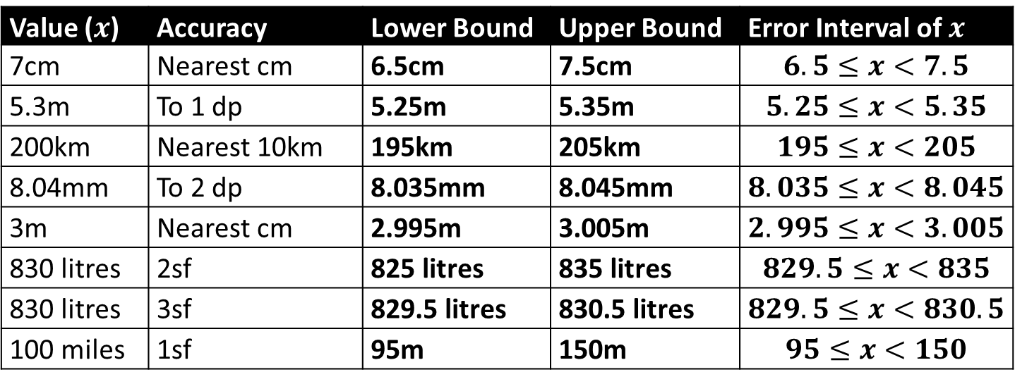
Mini Exercise
Work out the lower and upper bound for each value given the accuracy, and write the resulting error interval.
Value ($x$) | Accuracy | Lower Bound | Upper Bound | Error Interval of $x$
7cm | Nearest cm | 6.5cm | 7.5cm | $$6.5≤x<7.5$$
5.3m | To 1 dp | 5.25m | 5.35m | $$5.25≤x<5.35$$
200km | Nearest 10km | 195km | 205km | $$195≤x<205$$
8.04mm | To 2 dp | 8.035mm | 8.045mm | $$8.035≤x<8.045$$
3m | Nearest cm | 2.995m | 3.005m | $$2.995≤x<3.005$$
830 litres | 2sf | 825 litres | 835 litres | $$829.5≤x<835$$
830 litres | 3sf | 829.5 litres | 830.5 litres | $$829.5≤x<830.5$$
100 miles | 1sf | 95m | 150m | $$95≤x<150$$
?
?
?
?
?
?
?
?
?
?
?
?
?
?
?
?
?
?
?
?
?
For this last one the “+/- half the accuracy” trick breaks. Think carefully what the smallest and largest number is that would round correctly.

Slide 6
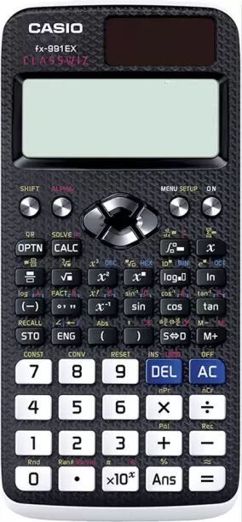




Truncation
Type in $2÷3$ into your calculator then press the S↔D key. Which do you get?
$$\frac{2}{3}=$$
$$\frac{2}{3}=$$
$$0.6666666666$$
$$0.6666666667$$
On older calculators you might have a 6 at the end. This is because the calculators cuts off (i.e. “truncates”) everything after the 10th decimal place without rounding the last digit up.
We say the value was truncated to 9 dp.
Truncating can be thought of as ROUNDING DOWN.
Your calculator will probably gives this second result. This was rounded to 10 dp; the 6 after the 10th 6 causes it to round up to 7.

Slide 7
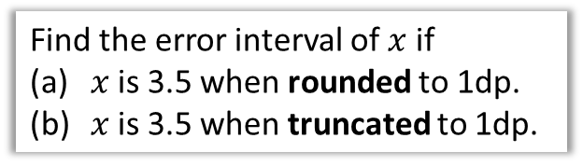
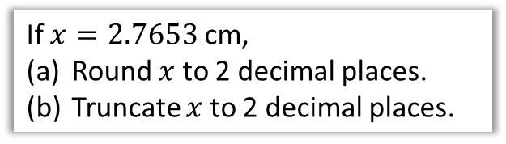


Truncation Examples
If $x=2.7653$ cm,
Round $x$ to 2 decimal places.
Truncate $x$ to 2 decimal places.
Find the error interval of $x$ if
$x$ is 3.5 when rounded to 1dp.
$x$ is 3.5 when truncated to 1dp.
Think very carefully about what the lowest and highest value might be!
2.77 cm
a
?
$$3.45≤x<3.55$$
a
?
2.76 cm
b
?
$$3.5≤x<3.6$$
We keep up to the 2nd decimal place, but simply discard everything after the 6 without checking the digit after.
b
?
3.49 for example would truncate to 3.4 which is too low. So the lowest value is 3.5.
3.59 would round to 3.6, but truncates to 3.5, so is not too high. Thus we can have everything up to (but excluding) 3.6.
3.4
3.5
3.6
3.7
Rounding:
Truncating:

Slide 8
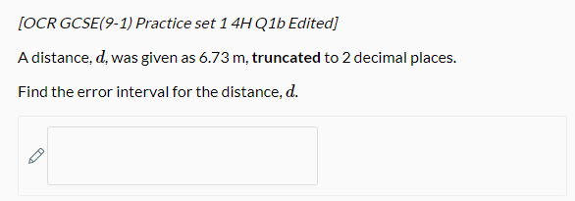

Test Your Understanding
?
$$6.73≤d<6.74$$

Slide 9
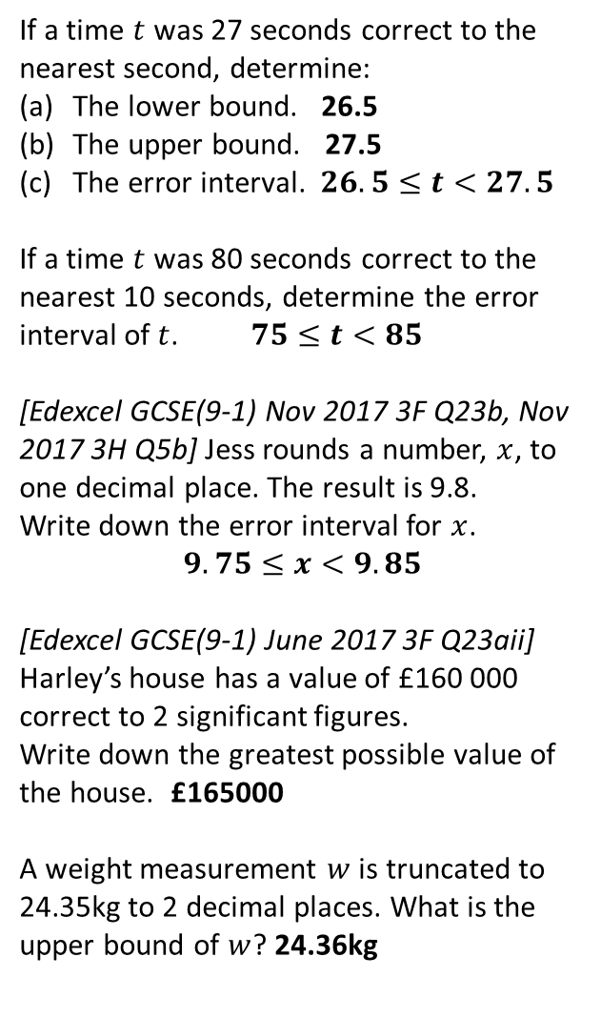
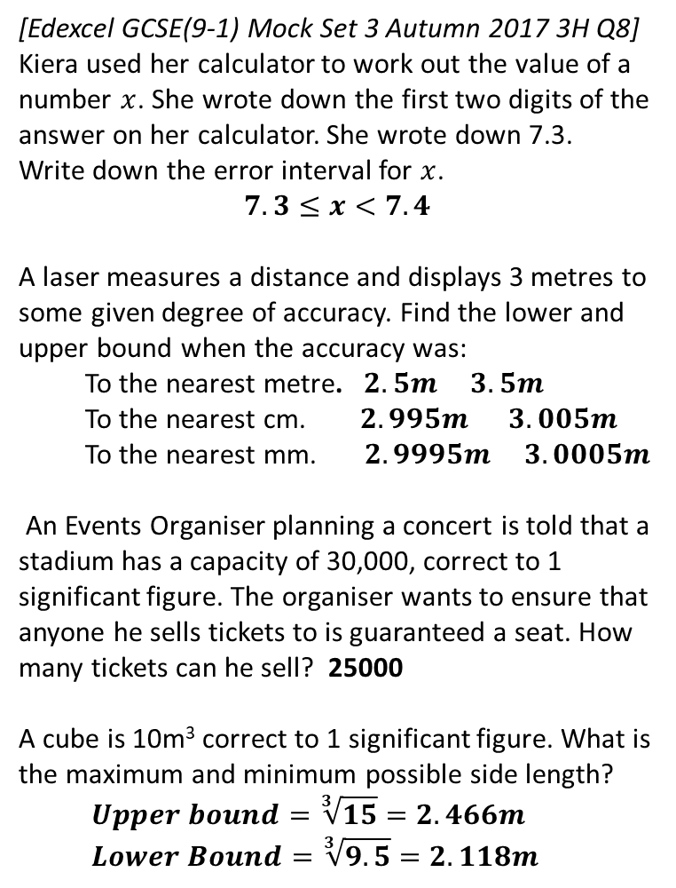
Exercise 1
1
If a time $t$ was 27 seconds correct to the nearest second, determine:
The lower bound. 26.5
The upper bound. 27.5
The error interval. $26.5≤t<27.5$
If a time $t$ was 80 seconds correct to the nearest 10 seconds, determine the error interval of $t$. $75≤t<85$
[Edexcel GCSE(9-1) Nov 2017 3F Q23b, Nov 2017 3H Q5b] Jess rounds a number, $x$, to one decimal place. The result is 9.8.
Write down the error interval for $x$.
$$9.75≤x<9.85$$
[Edexcel GCSE(9-1) June 2017 3F Q23aii]
Harley’s house has a value of £160 000 correct to 2 significant figures.
Write down the greatest possible value of the house. £165000
A weight measurement $w$ is truncated to 24.35kg to 2 decimal places. What is the upper bound of $w$? 24.36kg
6
[Edexcel GCSE(9-1) Mock Set 3 Autumn 2017 3H Q8] Kiera used her calculator to work out the value of a number $x$. She wrote down the first two digits of the answer on her calculator. She wrote down 7.3.
Write down the error interval for $x$.
$$7.3≤x<7.4$$
A laser measures a distance and displays 3 metres to some given degree of accuracy. Find the lower and upper bound when the accuracy was:
To the nearest metre. $2.5m 3.5m$
To the nearest cm. $2.995m 3.005m$
To the nearest mm. $2.9995m 3.0005m$
An Events Organiser planning a concert is told that a stadium has a capacity of 30,000, correct to 1 significant figure. The organiser wants to ensure that anyone he sells tickets to is guaranteed a seat. How many tickets can he sell? 25000
A cube is 10m³ correct to 1 significant figure. What is the maximum and minimum possible side length?
$$Upper bound=\sqrt[3]{15}=2.466m \\ Lower Bound=\sqrt[3]{9.5}=2.118m$$
?
?
?
?
2
7
?
3
?
?
?
?
8
4
?
?
N
5
?
?

Slide 10


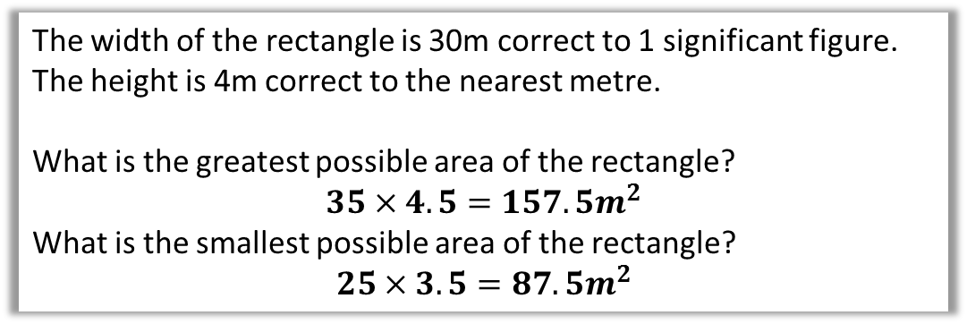
Bound Calculations
Sometimes we have to combine lower and upper bounds from different quantities…
$4$m
$30$m
The width of the rectangle is 30m correct to 1 significant figure. The height is 4m correct to the nearest metre.
What is the greatest possible area of the rectangle?
$$35×4.5=157.5m^{2}$$
What is the smallest possible area of the rectangle?
$$25×3.5=87.5m^{2}$$
If we’re multiplying two numbers and want the biggest overall result, it makes sense to use the biggest possible value for each number.
?
?

Slide 11


Further Example
A sewage tank has a volume of 1500 litres correct to 2 significant figures. Nick empties the tank using a large bucket which is 20 litres to the nearest litre.
What is the smallest number of times he must fill his bucket?
What is the greatest number of times?
?
$num times=\frac{vol of tank}{vol of bucket}$
$tank_{LB}=1450$ $tank_{UB}=1550$ $bucket_{LB}=19.5$ $bucket_{UB}=20.5$
$num times_{LB}=\frac{1450}{20.5}=70.7 →71$ times $num times_{UB}=\frac{1550}{19.5}=79.5 → 80$ times
Fro Tip: It’s helpful to write all your bounds out first.
Real Life Maths!

Slide 12


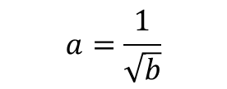




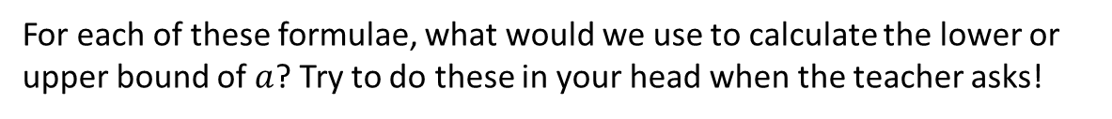

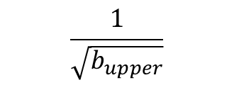



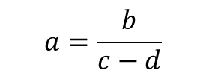





Quickfire Bound Calculations
For each of these formulae, what would we use to calculate the lower or upper bound of $a$? Try to do these in your head when the teacher asks!
Formula
We want
Calculation
$$a=b×c$$
Upper bound of $a$.
$$b_{upper}×c_{upper}$$
If we want a big number, we choose the biggest for each!
$$\frac{b_{lower}}{c_{upper}}$$
If we want small, we start with a small number and divide by a big.
$$a=\frac{b}{c}$$
Lower bound of $a$.
?
?
$$a=b+c$$
Lower bound of $a$.
$$b_{lower}+c_{lower}$$
$$a=b−c$$
Upper bound of $a$.
$$b_{upper}−c_{lower}$$
?
$$\frac{b_{upper}}{c_{lower}−d_{upper}}$$
$$a=\frac{b}{c−d}$$
?
Upper bound of $a$.
$$\frac{1}{\sqrt{b_{upper}}}$$
$$a=\frac{1}{\sqrt{b}}$$
?
Lower bound of $a$.

Slide 13
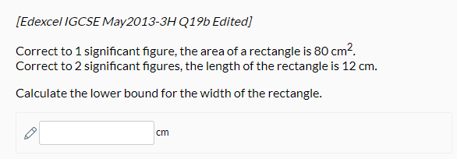

Test Your Understanding
$$75÷12.5=6$$
?

Slide 14

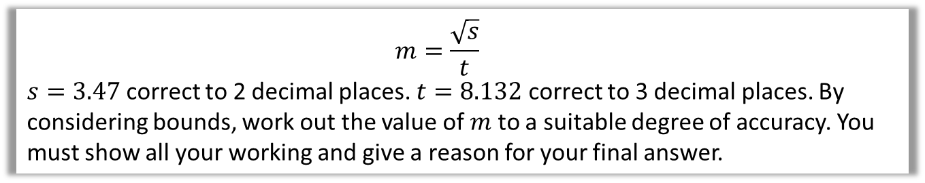


Giving answer to “suitable degree of accuracy”
$$m=\frac{\sqrt{s}}{t}$$
$s=3.47$ correct to 2 decimal places. $t=8.132$ correct to 3 decimal places. By considering bounds, work out the value of $m$ to a suitable degree of accuracy. You must show all your working and give a reason for your final answer.
Find bounds of each variable ?
$$s_{lower}=3.465 s_{upper}=3.475 \\ t_{lower}=8.1315 t_{upper}=8.1325$$
$$m_{lower}=\frac{\sqrt{s_{lower}}}{t_{upper}}=\frac{\sqrt{3.465}}{8.1325}=0.2288903… \\ m_{upper}=\frac{\sqrt{s_{upper}}}{t_{lower}}=\frac{\sqrt{3.475}}{8.1315}=0.2292486…$$
$m=0.229$ “as both the lower bound and upper bound are this to 3dp”.
Use to find bounds of $m$ ?
If we had to only choose a single value for $m$, what would be most sensible?
We don’t know where $m$ is between the 0.2289… and 0.2292… Ideally we want to quote a value of $m$ such that we would round to this same value regardless of what $m$ actually was, but still give as much accuracy as possible..
?
Final value of $m$ and why ?

Slide 15
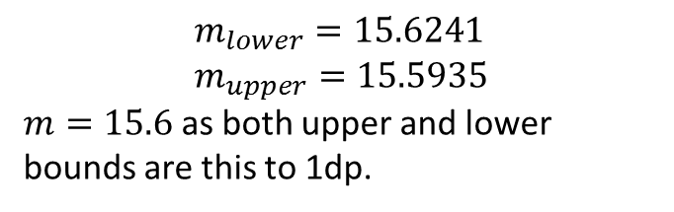
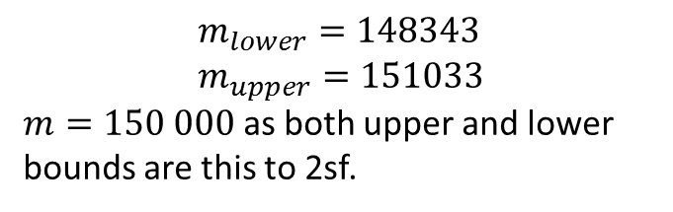
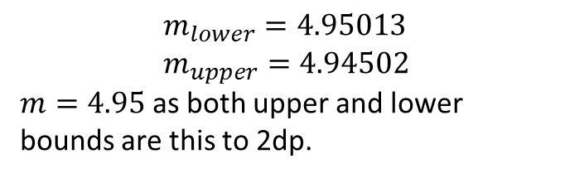
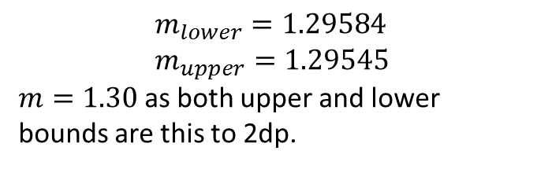
Practising that last step…
In each case you’re trying to find a single suitable value of $m$ to use (with justification), and you’ve calculated the upper and lower bounds.
$$m_{lower}=15.6241 \\ m_{upper}=15.5935$$
$m=15.6$ as both upper and lower bounds are this to 1dp.
$$m_{lower}=148343 \\ m_{upper}=151033$$
$m=150 000$ as both upper and lower bounds are this to 2sf.
?
?
$$m_{lower}=4.95013 \\ m_{upper}=4.94502$$
$m=4.95$ as both upper and lower bounds are this to 2dp.
$$m_{lower}=1.29584 \\ m_{upper}=1.29545$$
$m=1.30$ as both upper and lower bounds are this to 2dp.
?
?

Slide 16
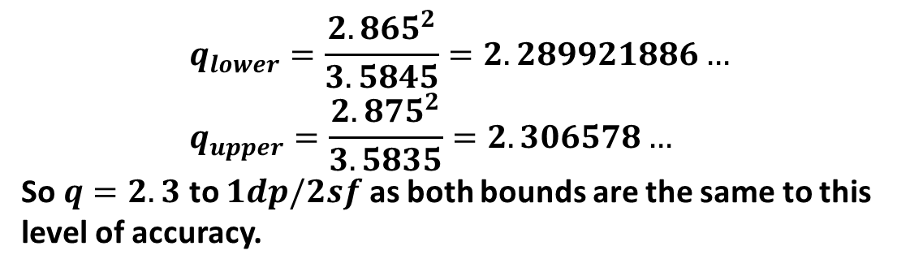
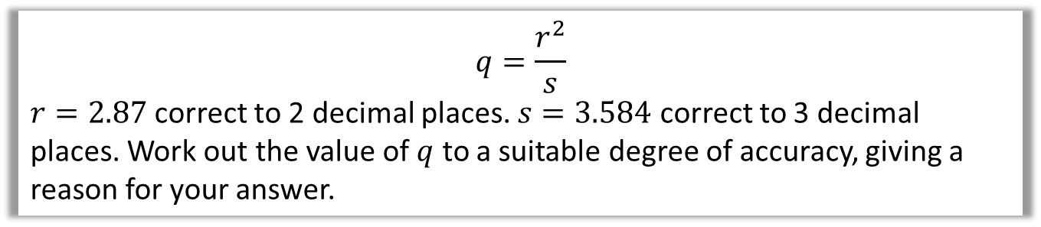
Test Your Understanding
$$q=\frac{r^{2}}{s}$$ $r=2.87$ correct to 2 decimal places. $s=3.584$ correct to 3 decimal places. Work out the value of $q$ to a suitable degree of accuracy, giving a reason for your answer.
?
$$q_{lower}=\frac{{2.865}^{2}}{3.5845}=2.289921886… \\ q_{upper}=\frac{{2.875}^{2}}{3.5835}=2.306578…$$
So $q=2.3$ to $1dp/2sf$ as both bounds are the same to this level of accuracy.

Slide 17
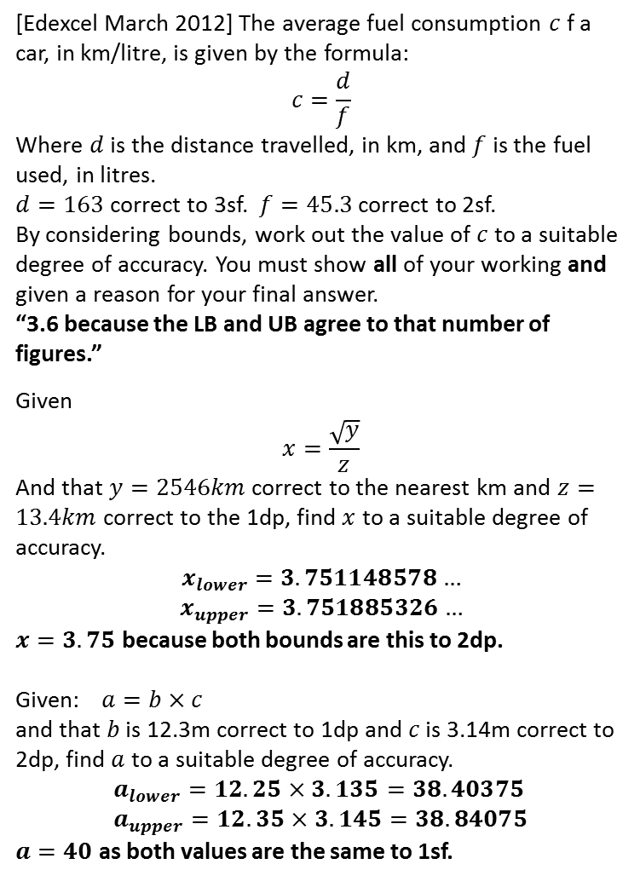
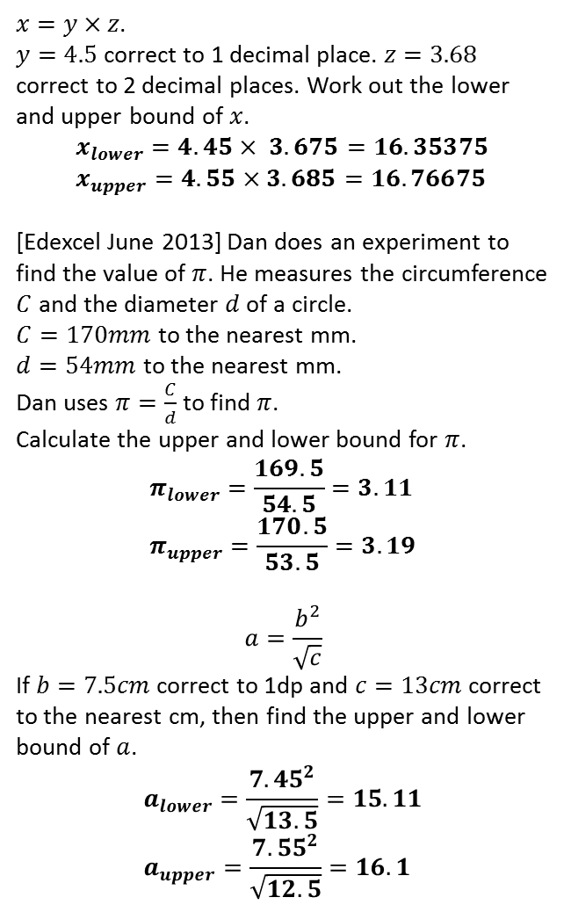
Exercise 2
(on provided worksheet)
1
$x=y×z$. $y=4.5$ correct to 1 decimal place. $z=3.68$ correct to 2 decimal places. Work out the lower and upper bound of $x$.
$$x_{lower}=4.45× 3.675=16.35375 \\ x_{upper}=4.55×3.685=16.76675$$
[Edexcel June 2013] Dan does an experiment to find the value of $π$. He measures the circumference $C$ and the diameter $d$ of a circle.
$C=170mm$ to the nearest mm.
$d=54mm$ to the nearest mm.
Dan uses $π=\frac{C}{d}$ to find $π$.
Calculate the upper and lower bound for $π$.
$$π_{lower}=\frac{169.5}{54.5}=3.11 \\ π_{upper}=\frac{170.5}{53.5}=3.19$$
$$a=\frac{b^{2}}{\sqrt{c}}$$
If $b=7.5cm$ correct to 1dp and $c=13cm$ correct to the nearest cm, then find the upper and lower bound of $a$.
$$a_{lower}=\frac{{7.45}^{2}}{\sqrt{13.5}}=15.11 \\ a_{upper}=\frac{{7.55}^{2}}{\sqrt{12.5}}=16.1$$
4
[Edexcel March 2012] The average fuel consumption $c$ f a car, in km/litre, is given by the formula:
$$c=\frac{d}{f}$$
Where $d$ is the distance travelled, in km, and $f$ is the fuel used, in litres.
$d=163$ correct to 3sf.$f=45.3$ correct to 2sf.
By considering bounds, work out the value of $c$ to a suitable degree of accuracy. You must show all of your working and given a reason for your final answer.
“3.6 because the LB and UB agree to that number of figures.”
Given
$$x=\frac{\sqrt{y}}{z}$$
And that $y=2546km$ correct to the nearest km and $z=13.4km$ correct to the 1dp, find $x$ to a suitable degree of accuracy.
$$x_{lower}=3.751148578…$$
$$x_{upper}=3.751885326…$$
$x=3.75$ because both bounds are this to 2dp.
Given:$a=b×c$
and that $b$ is 12.3m correct to 1dp and $c$ is 3.14m correct to 2dp, find $a$ to a suitable degree of accuracy.
$$a_{lower}=12.25×3.135=38.40375 \\ a_{upper}=12.35×3.145=38.84075$$
$a=40$ as both values are the same to 1sf.
?
2
?
5
?
?
3
6
?
?

Slide 18
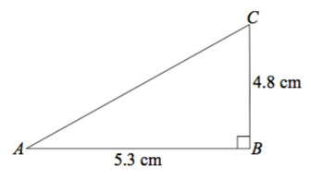
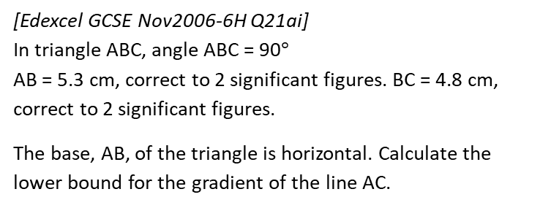
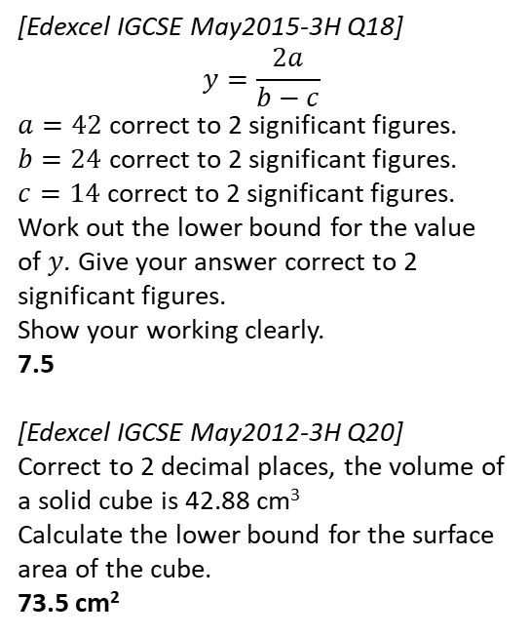
Exercise 2
(on provided worksheet)
7
[Edexcel GCSE Nov2014-2H Q23 Edited] A road is 4530 m long, correct to the nearest 10 metres. Kirsty drove along the road in 205 seconds, correct to the nearest 5 seconds.
The average speed limit for the road is 80 km/h. What is greatest Kirsty's speed could have been? Give your answer correct to 1 decimal place.
80.6 km/h
9
[Edexcel IGCSE May2015-3H Q18]
$$y=\frac{2a}{b−c}$$
$a=42$ correct to 2 significant figures. $b=24$ correct to 2 significant figures. $c=14$ correct to 2 significant figures.
Work out the lower bound for the value of $y$. Give your answer correct to 2 significant figures. Show your working clearly.
7.5
[Edexcel IGCSE May2012-3H Q20]
Correct to 2 decimal places, the volume of a solid cube is 42.88 cm³
Calculate the lower bound for the surface area of the cube.
73.5 cm²
?
?
10
8
[Edexcel GCSE Nov2006-6H Q21ai] In triangle ABC, angle ABC = 90$°$ AB = 5.3 cm, correct to 2 significant figures. BC = 4.8 cm, correct to 2 significant figures.
The base, AB, of the triangle is horizontal. Calculate the lower bound for the gradient of the line AC.
?
?
0.89

